Slide 1
ESW Project
Indoor air pollution(week-1)(17-8-2021)

Slide 2
Team Details(Team 26)
P. Seetha Raghavendra 2019101074
D. Praneeth 2019101002
M. Revanth 2019101052
T. Sai Sathwik 2019101045
Soma Datta reddy 2019111018

Slide 3
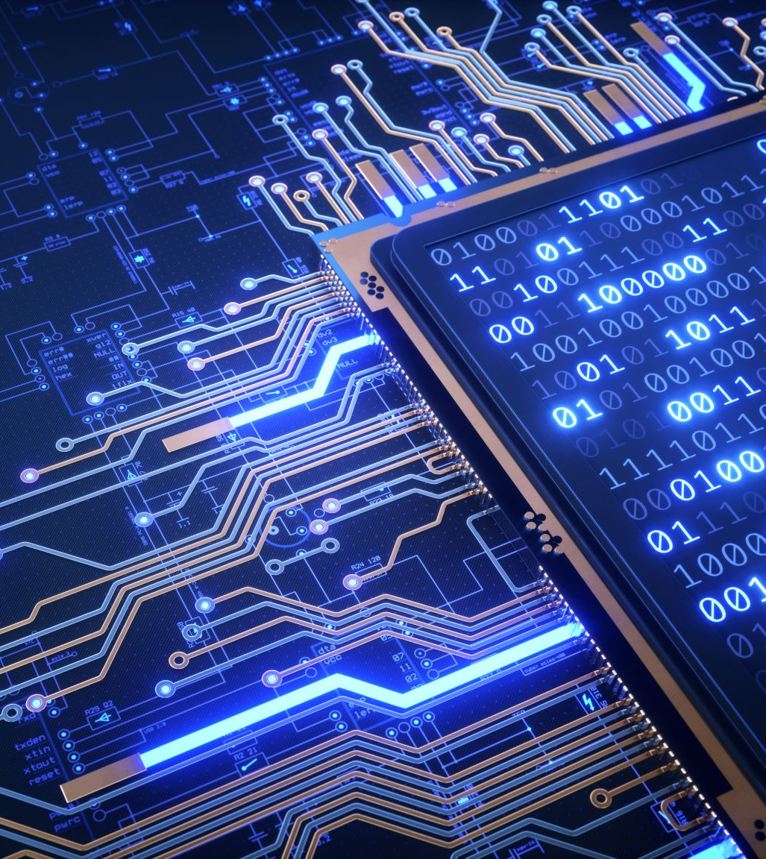
Week1-Sensor Interfacing
This week we got familiar with the sensors provided.
We interfaced sensor and got the readings from it. From the different environments.
We used esp32 as our microcontroller and checked every sensor one at a time more about that in the upcoming slides where we provided detailed explanation about them.

Slide 4
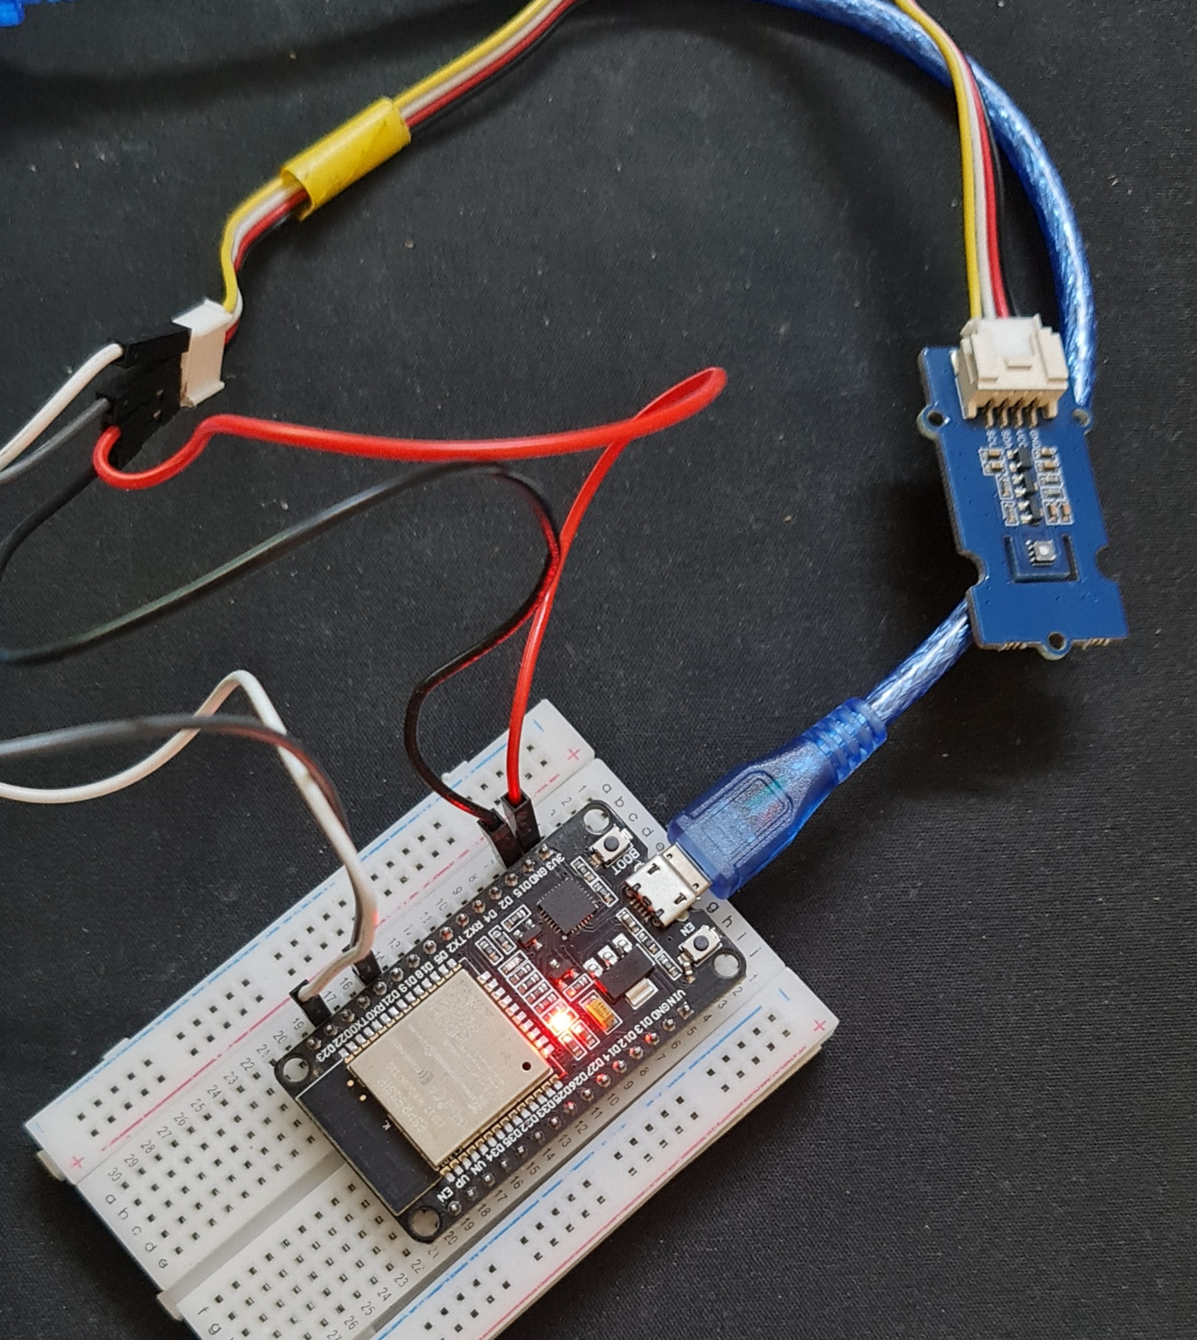
Sensor-SGP30
The SGP30 sensor used to detect voc(in ppb), co2(in ppm), raw H2(in ppm),raw ethanol(in ppm).
Tested the sensor in different places.
In next phase we will push the values to the Thingspeak.
And need to decide the threshold value when the value is max at a place and alert when the specified value increases the threshold value

Slide 5
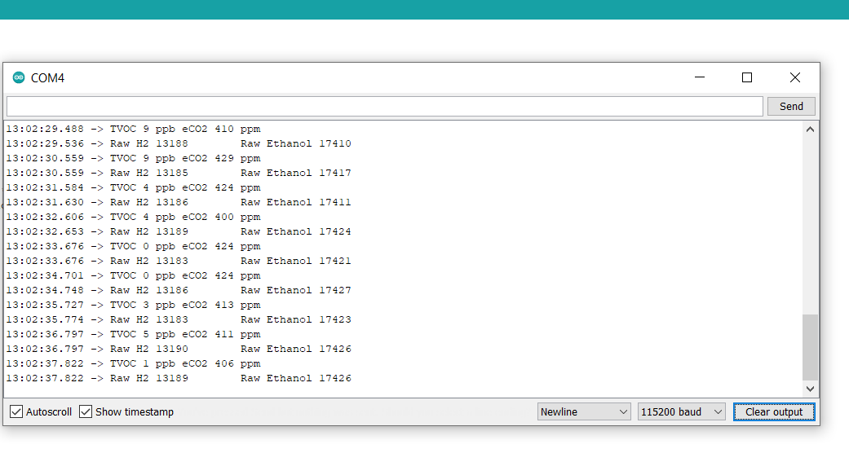
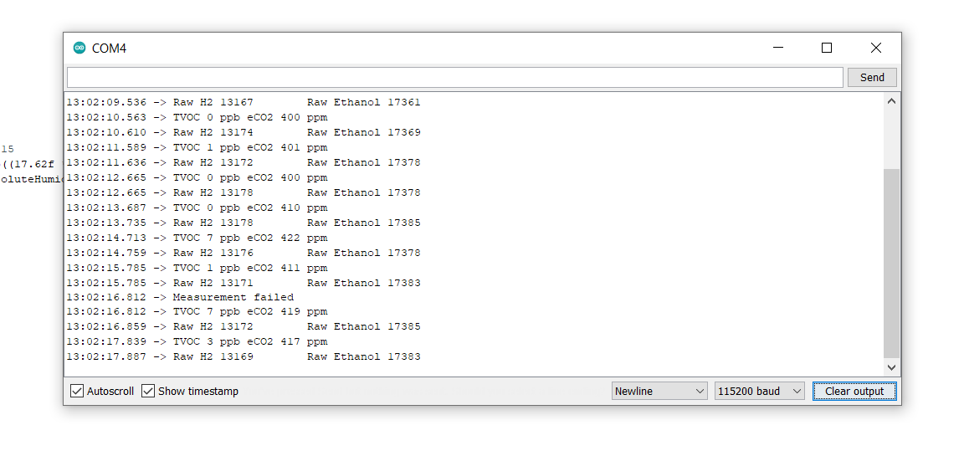
Sensor-SGP30
Some of the readings screenshot this week.

Slide 6
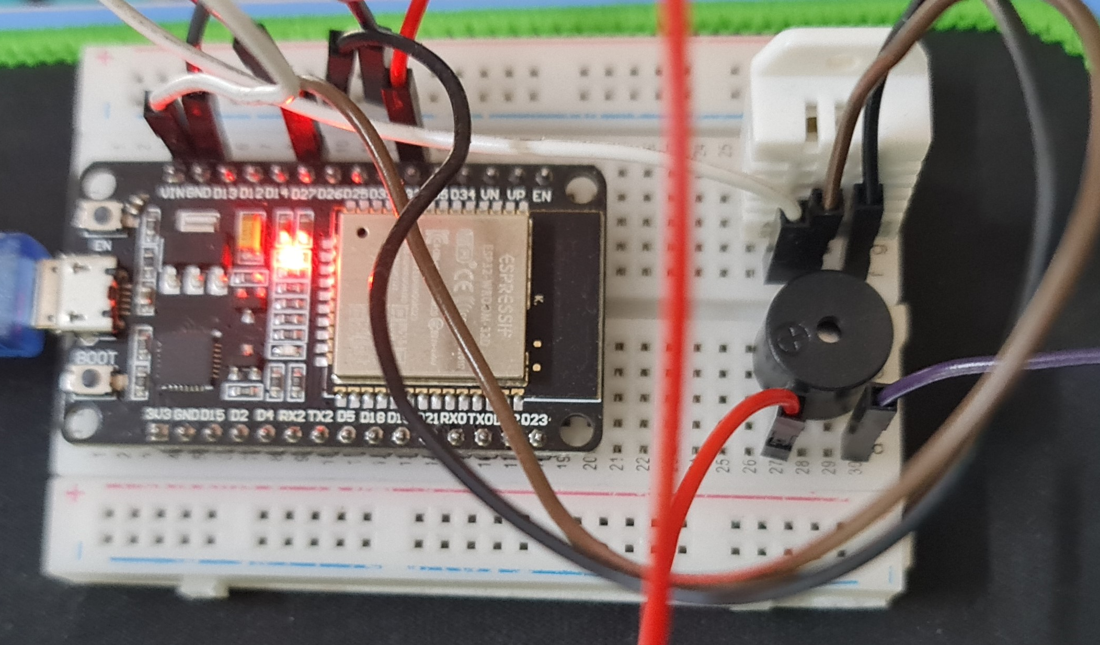
Sensor-DHT22
For the DHT22 sensor this gives the values for the temperature and humidity.
This sensor values are pushed into the Thingspeak.
For the next phase is onem2m integration.

Slide 7
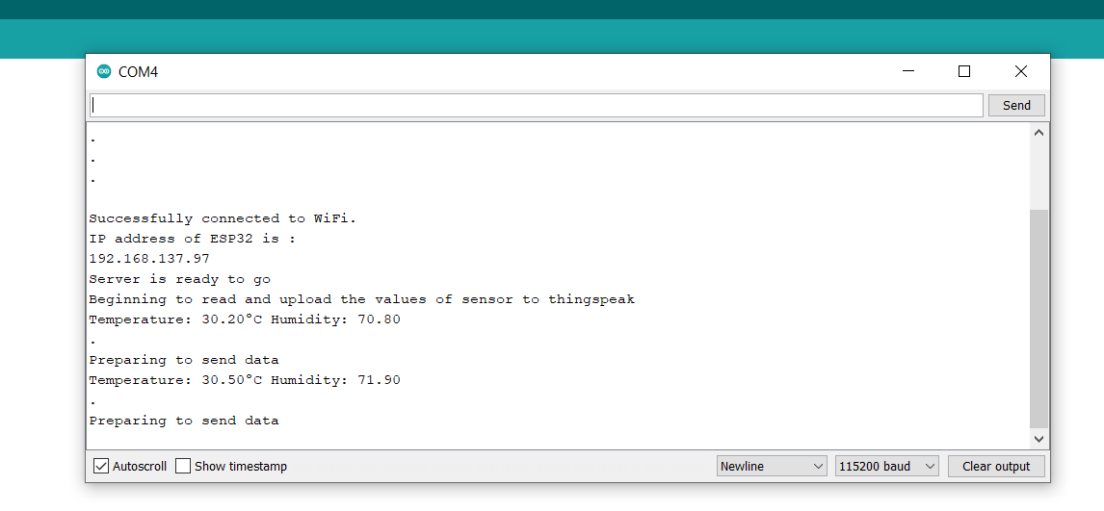
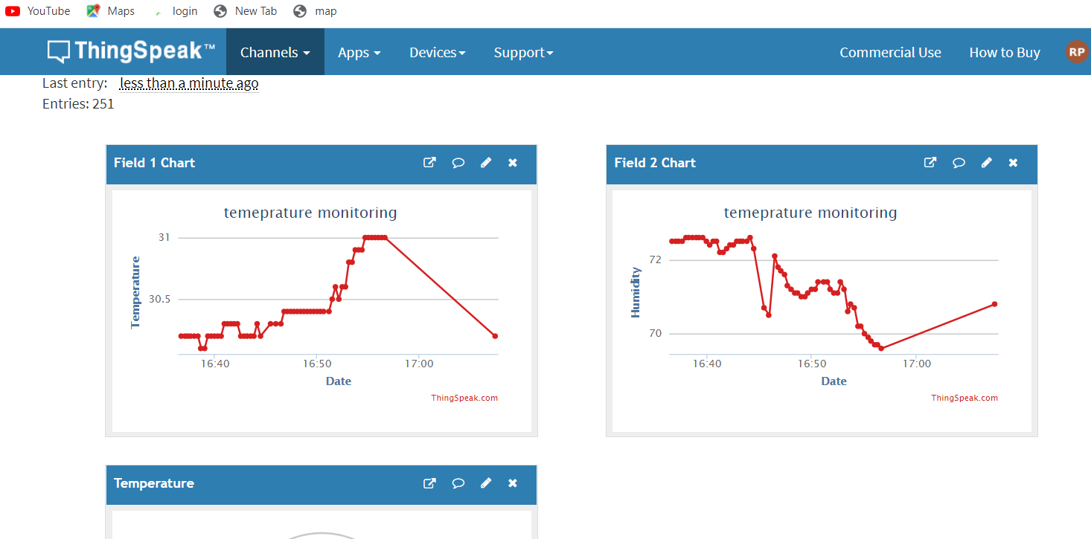
Sensor DHT22
Screenshots of the data read by sensor.

Slide 8
Sensor-BMP280(clarification)
The BMP280 sensor integrates atmospheric pressure, temperature and relative humidity sensors in a single device, with great precision, low energy consumption and an ultra compact format
While using this sensor the values are not displaying, we checked the wiring ,code, i2c device address there is no problem with it.

Slide 9
Sensor-Nova pm sensor sds011
Sds011 sensor is used to get the values of dust particles and smoke concentration in the air.

Slide 10
Next week-Goals
P.S Raghavendra.
Thingspeak integration.
Sensors checking for bmp280.
One week sensor data collection on Thingspeak
Revanth
Collecting data from Vijayawada.
Getting the sensors ready.
Soma
-working on the web interface for the project.
Sai
-oneM2m integration

Slide 11
Next week-Goals
Praneth
-data analysis and documentation

Slide 12

Thank you

